Slide 1

Movie Recommendation System
Date : 21ST Sept,2023

Slide 2
Recommender System is a system that seeks to predict or filter preferences according to the user’s choices. Recommender systems are utilized in a variety of areas including movies, music, news, books, research articles, search queries, social tags, and products in general. Moreover, companies like Netflix and Spotify depend highly on the effectiveness of their recommendation engines for their business and success.
Date : 21ST Sept,2023
Recommendation System :

Slide 3




Timeline
Movie Recommendation System
Introduction
Discussed what kind of data is needed for the project. What are the features that are required for the project
Data collection
Collected suitable data which is required
Data Cleaning
We have seen the data contains nulls, So we removed and performed a basic EDA.
Recommendation
System
Worked on building recommendation system

Slide 4
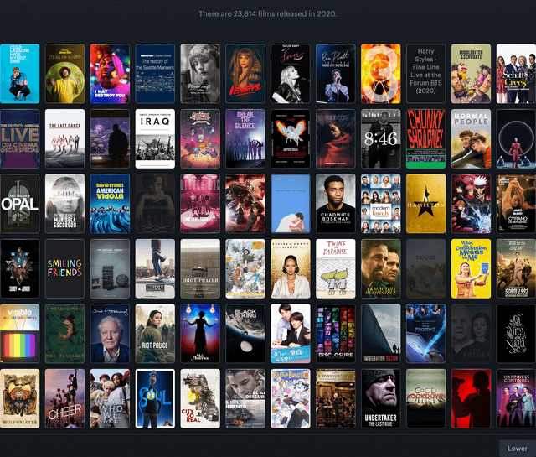
Importance of Movie Recommendation Systems: Movie recommendation systems play a crucial role in enhancing user experience and engagement in the entertainment industry. Purpose and Objectives of the Project: Our project aims to develop an effective movie recommendation system using cosine similarity.
Participent names
Participent names

Slide 5
Problem Statement
Imagine you're scrolling through your favorite streaming service, like Netflix or Amazon Prime, trying to decide what movie to watch. You have so many options that it can be really hard to pick one. This is the problem we're trying to solve.
We want to make it easier for you to find movies that you'll enjoy. Instead of scrolling through hundreds of options, our system will suggest movies that match your tastes. It's like having a helpful friend who knows what you like and can recommend the perfect movie for you. This way, you can spend less time searching and more time enjoying great films!

Slide 6

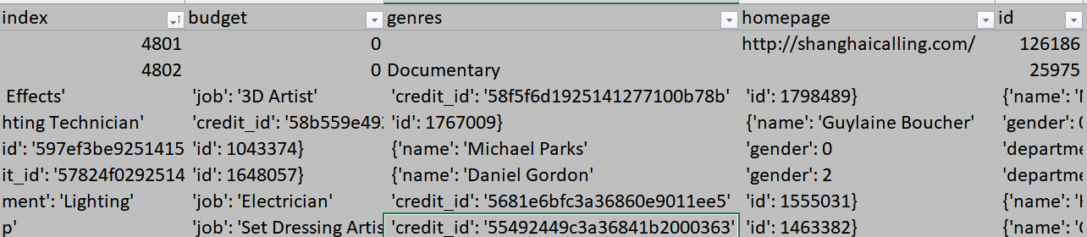
Data Collection & Cleaning
Data Collection & Cleaning
Basic EDA
We have removed the null values and irrelevant values. As well as few columns which are not necessary for the movie recommendation system
Model Build
Link to the dataset : click here

Slide 7
Data Collection & Cleaning
Basic EDA
Model Build
Steven Spielberg leads with 27 movies, closely followed by Clint Eastwood, Martin Scorsese, Renny Harlin, and Ridley Scott, each with 15 films.
In terms of votes, Christopher Nolan stands out with 62,653 votes, followed by Steven Spielberg, Peter Jackson, Quentin Tarantino, and Ridley Scott, all contributing significantly to the vote count.

Slide 8
Data Collection & Cleaning
Basic EDA
Model Build
Drama and Comedy are the most prolific genres, with 243 and 221 movies, respectively.
Comedy also tops the vote count with 122,050 votes, followed closely by Drama with 119,471 votes.

Slide 9
Basic EDA
Model Build
Movie Description Based Recommender:
The "Movie Recommendation System" represents the Movie Description Based Recommender, which uses the descriptions or plots of movies to recommend films that match a person's preferences. It's like having a magical guide to help you discover the perfect movie for any mood or occasion.
For more information about the model link is provided below : click here

Slide 10
Basic EDA
Model Build
Pros :
Personalized User Experience: : Recommendation systems provide users with personalized content suggestions based on their preferences, improving the overall user experience.
Increased Engagement: By suggesting relevant movies or content, these systems keep users engaged and can lead to longer viewing or interaction times.
Discovery of New Content : Users can discover new movies and genres they may not have considered before, broadening their horizons.
Cons :
Cold Start Problem : Recommending content for new users or new items can be challenging when there is limited data available.
Privacy Concerns: Recommendation systems often rely on user data, raising privacy concerns if this data is mishandled or misused.
Content Overlooked: Less popular or niche content may be overlooked if the system heavily promotes mainstream or trending items.

Slide 11

Conclusion
The result is a list of recommended movies that are considered similar to the user's favorite movie, with the most similar ones appearing at the top of the list. The number of recommendations displayed is limited to the first 10 similar movies. The user can explore these recommendations to find movies that align with their preferences based on the similarity metric used.

Slide 12

Team
Thank you
Nivedhitha Gurunathan
Vikas Namdev
Alekhya Alapati
Ambarish Raju
Ashutosh singh Gautam
Muthu Murugan V
Kadhiri Sridhar
Mohammad Aarish Qureshi
Aishwarya Shinde

Slide 13
Thank you

